Slide 1

Support vector regression
2
+
<shridhar hegde/>
07, July. 2019.

Slide 2
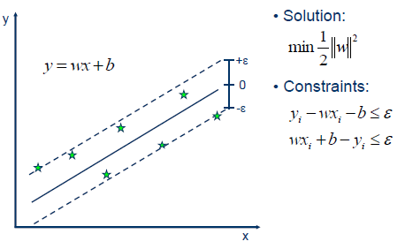
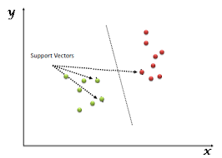
Support vector {regression | machine}
SVR is a “REGRESSION” algorithm
SVM is a “CLASSIFICATION” algorithm

Slide 3
Support vector Regression vs simple regression
In simple regression, we try to minimise the error rate.
But in SVR, we try to fit the error within a certain threshold.
This might sound bit confusing at the beginning, but let me explain.

Slide 4
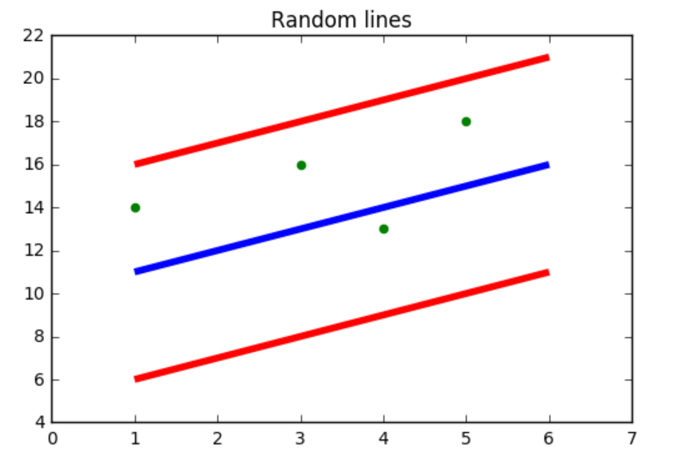
SVR Explanation
Hyper Plane
In SVM this is basically the separation line between the data classes.
Although in SVR we are going to define it as the line that will help us predict the continuous value or target value as we did in simple regression.
Boundary Line
In SVM there are two lines other than Hyper Plane which creates a margin . The support vectors can be on the Boundary lines or outside it. This boundary line separates the two classes.
In SVR the concept is same.
The blue line is called the “Hyper Plane”
The red lines are called the “Boundary Lines”

Slide 5
SVR Explanation
In the figure, all the points are within the boundary line(Red Line).
Our objective when we are moving on with SVR is to consider the points that are within the boundary line. Our best fit line is the line hyperplane that has maximum number of points.
So the first thing we have to understand is what is this boundary line ?
The blue line is called the “Hyper Plane”
The red lines are called the “Boundary Lines”
Think of it as to lines which are at a distance of ‘d’.
So the lines that we draw are at ‘+d’ and ‘-d’ distance from the hyper plane.

Slide 6
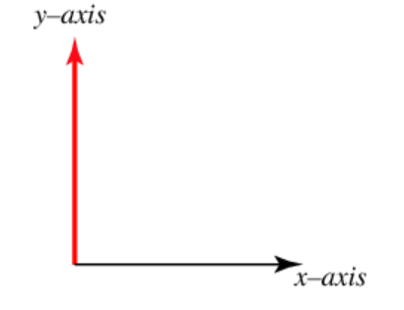
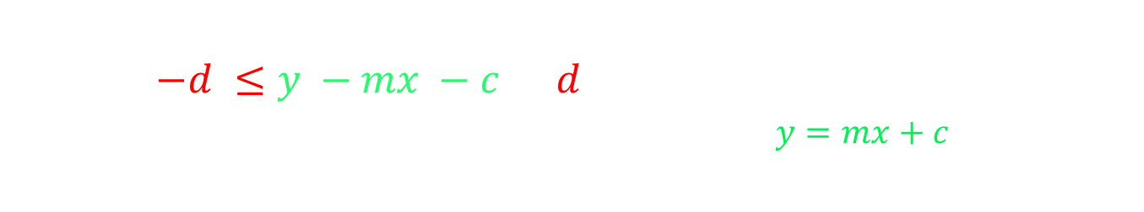
SVR explanation
Let us assume that the Hyper Plane is passing through the y-axis
Then, the equation of the Hyper Plane will be
m x + c = 0
The equation of the two boundary lines will then become
m x + c = d
m x + c = - d
Thus, for any linear hyper plane the equation that satisfy our SVR is
$−d ≤y −mx −c≤d$
given that the equation of a straight line is $y=mx+c$

Slide 7
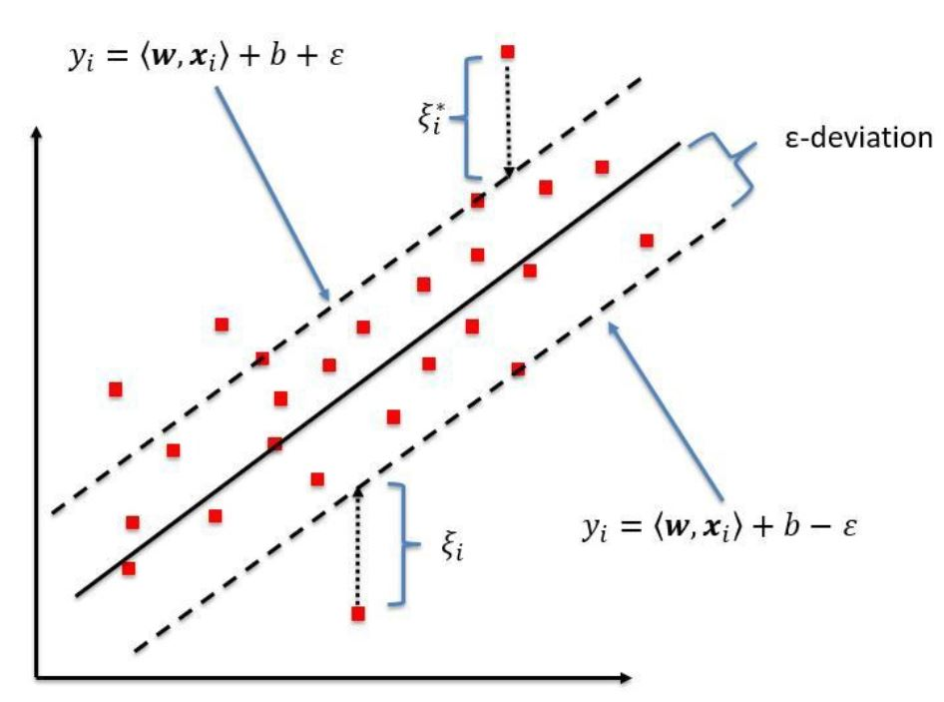
SUMMARY
What we are trying to do here is basically trying to decide a decision boundary at ‘d’ distance from the original hyper plane such that data points closest to the hyper plane or the support vectors are within that boundary line.

Slide 8
SUMMARY
Thus the decision boundary is our Margin of Tolerance. That is, we are going to take only those points who are within this boundary.

Slide 9
SUMMARY
In simple terms, we are going to take only those points which have least error rate thus giving us a better fitting model.

Slide 10
Thank You
Any Questions ?

